Slide 1
ShopForHome
Name : Tejal Sharad Urhe
Date : 8 September 2025
Batch : WIPRO NGA - .Net Full Stack Angular - FY26 - C2
Instructor : Jyoti Patil Mam

Slide 2
Table of Contents
Contents | Page No
Title Page | 1
Problem Definition | 3
Project Goal | 4
Project Objectives | 5
Frontend & Backend Architecture | 6
System Design | 7
State management, routing, UI components | 8
API design, endpoints, authentication mechanism | 9
Entity-Relationship Diagram | 11
System Requirements and Working Flow | 13

Slide 3
Problem Definition
ShopForHome is a retail store for home décor that relied on offline sales. Due to COVID‑19, offline operations were disrupted, and the business needs an online platform.
The goal is to create a web application where users can browse and purchase products, and admins can manage products, users, and reports.

Slide 4
Project Goal
Build a web application for Shop-For-Home using Angular (frontend) and ASP.NET Core MVC (backend).
Provide a smooth shopping experience for users with browsing, filtering, cart, and wishlist features.
Enable admins to manage products, users, stock, coupons, and sales reports.

Slide 5
Project Objectives
Implement login, logout, and registration for Users and Admins.
Allow browsing and filtering of products by category, price, and rating.
Provide cart and wishlist features for Users.
Support product and user CRUD operations for Admins.
Implement bulk product upload using CSV and stock management with alerts.
Generate sales reports and manage discount coupons.

Slide 6
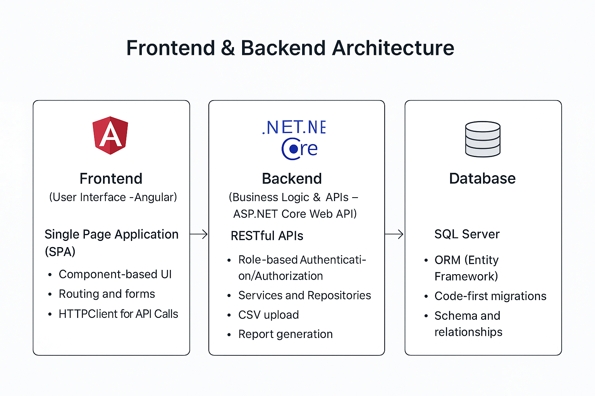

Slide 7
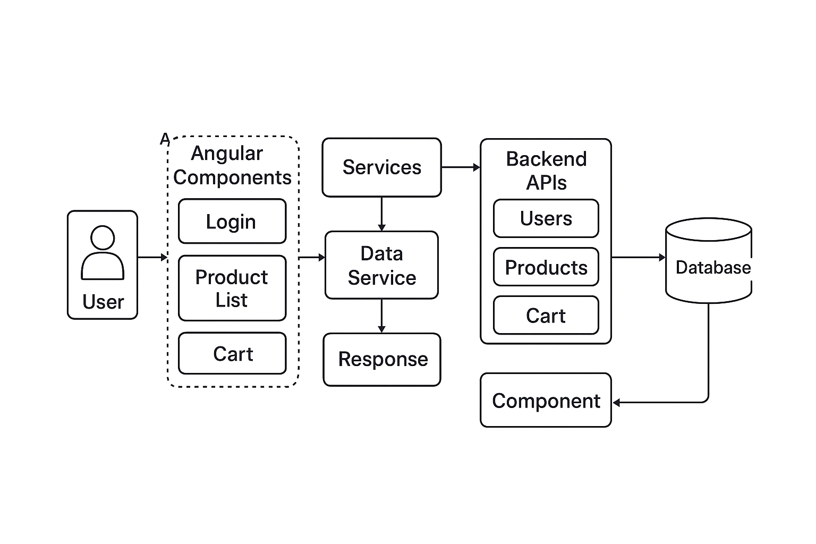
System design

Slide 8
State management, routing, UI components :

Slide 9
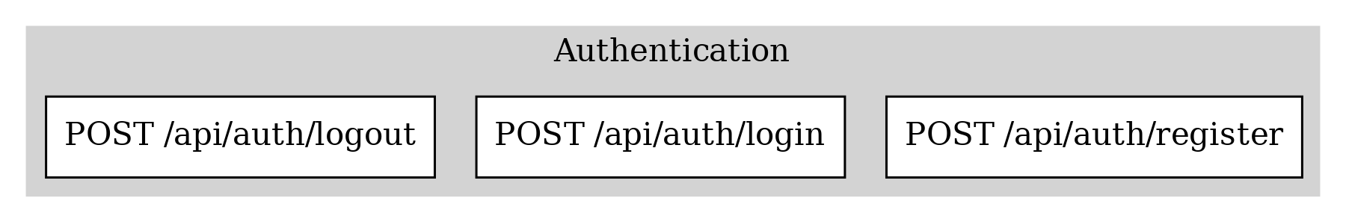
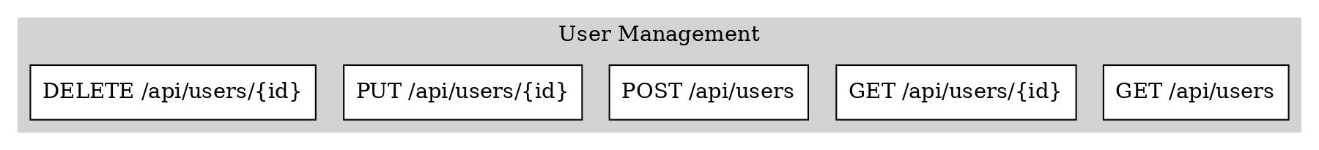
API design, endpoints, authentication mechanism

Slide 10
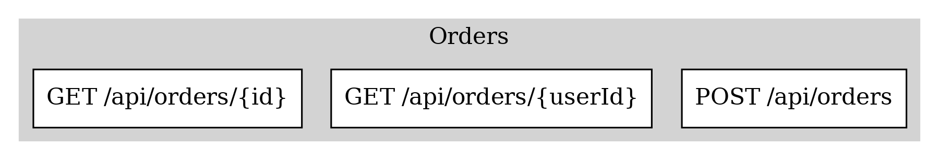
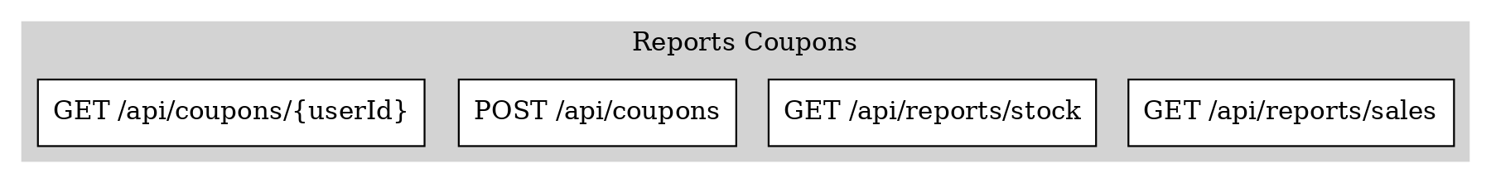

Slide 11
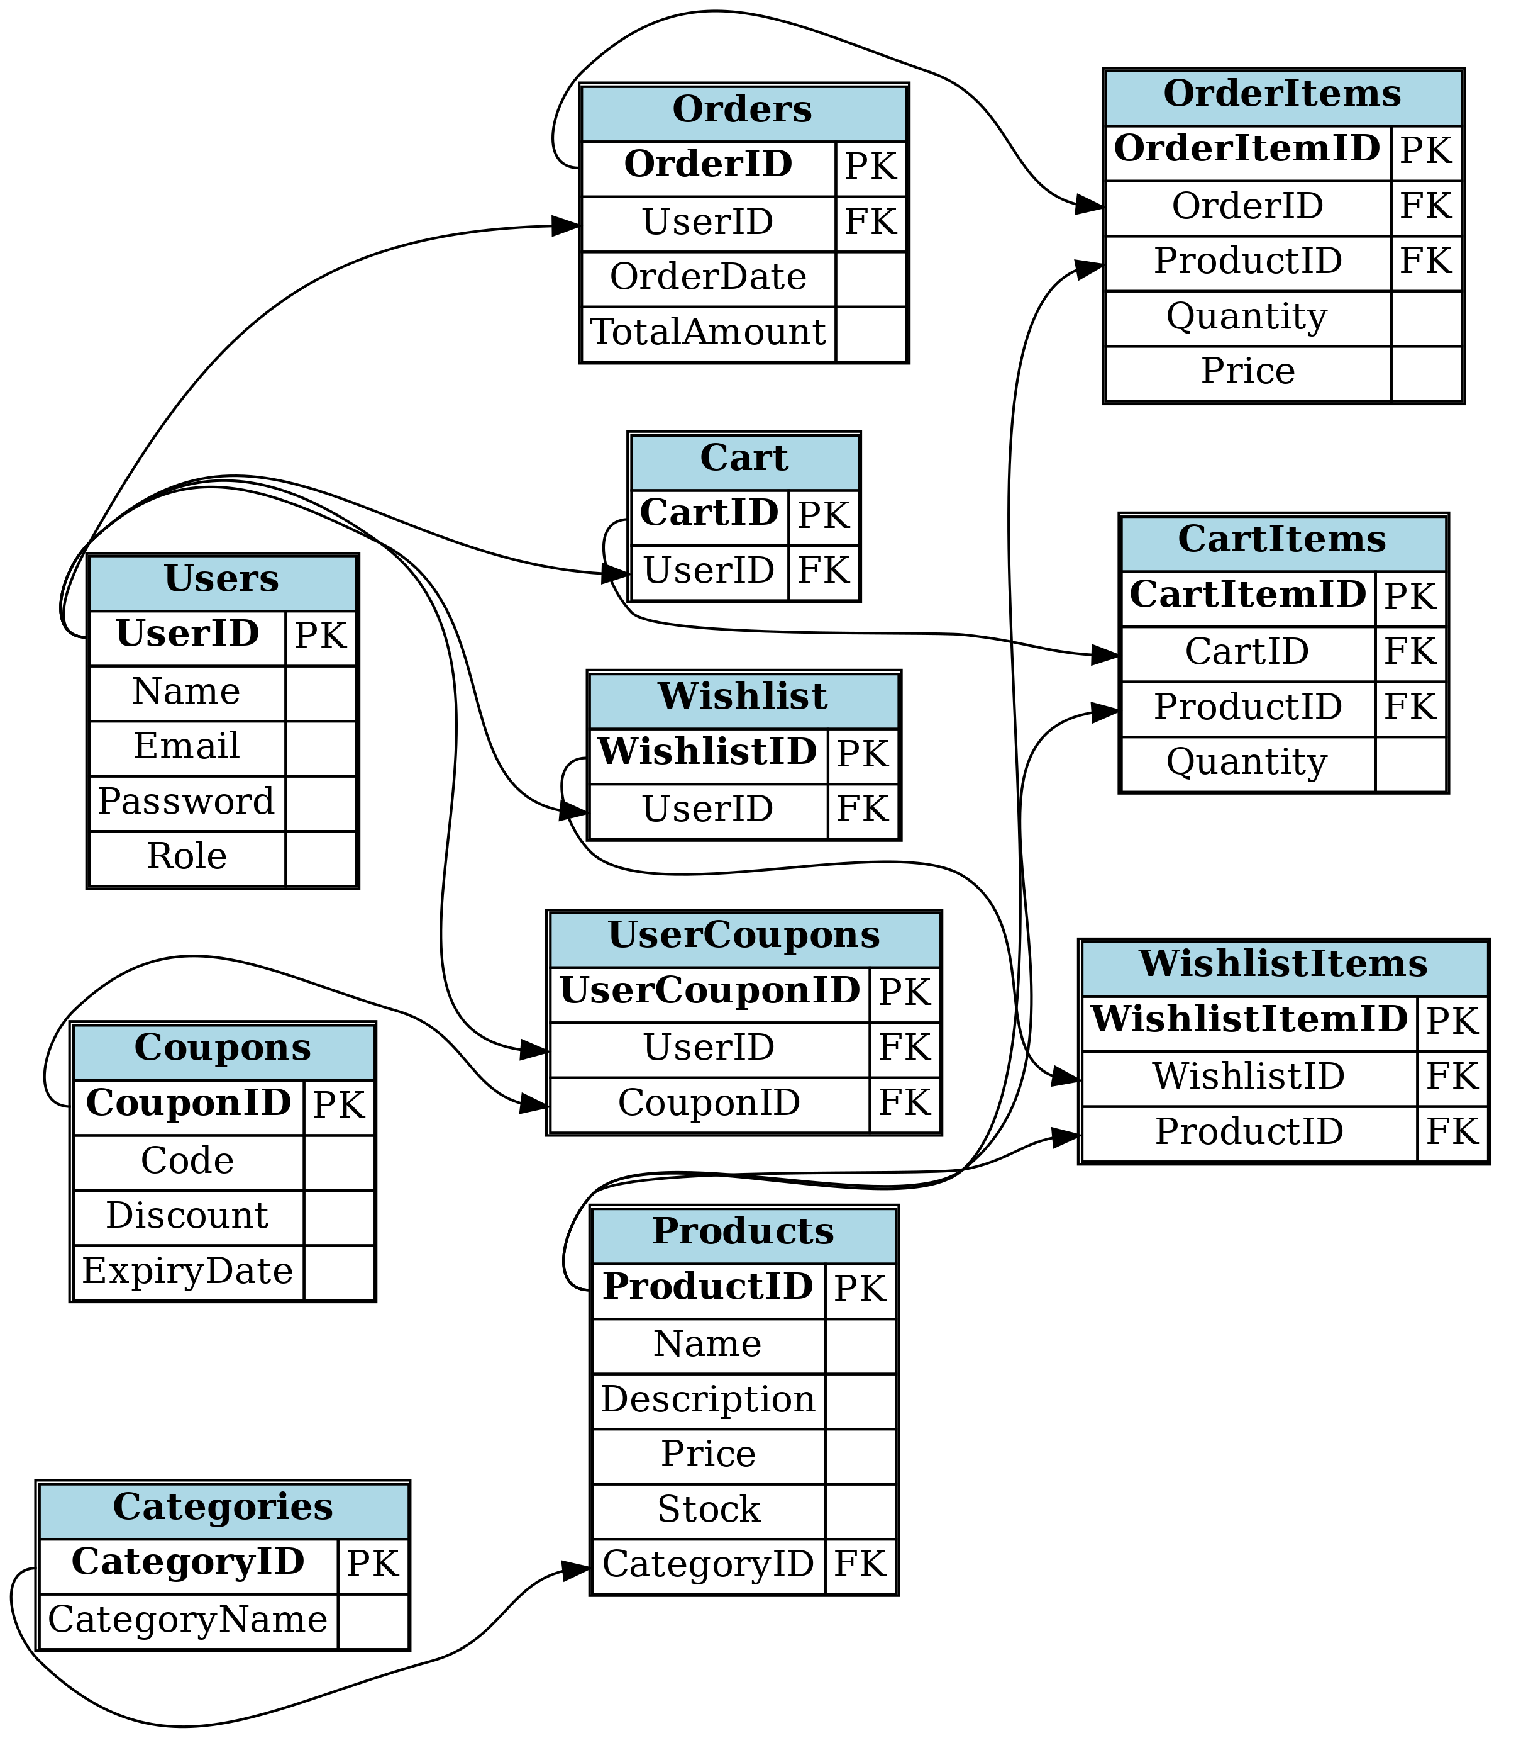
Entity-Relationship Diagram :

Slide 12
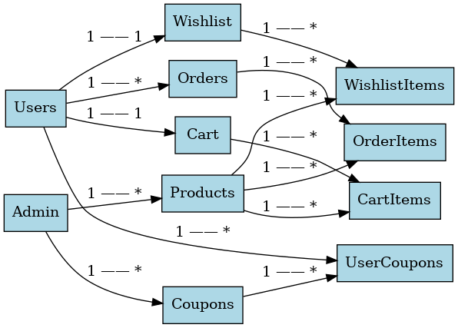

Slide 13
System Requirements :
Frontend: Angular 19, TypeScript, Angular CLI, RxJS
Backend: ASP.NET Core 9, C# 12, Entity Framework Core 9, Swagger (API Docs)
Middleware/Tools: Node.js 22 (npm 10+), Visual Studio 2022, VS Code
Database: MS SQL Server 2022
Auth: JWT-based authentication, role-based access(admin , user)
CLI Commands For Execution
dotnet run
ng serve

Slide 14
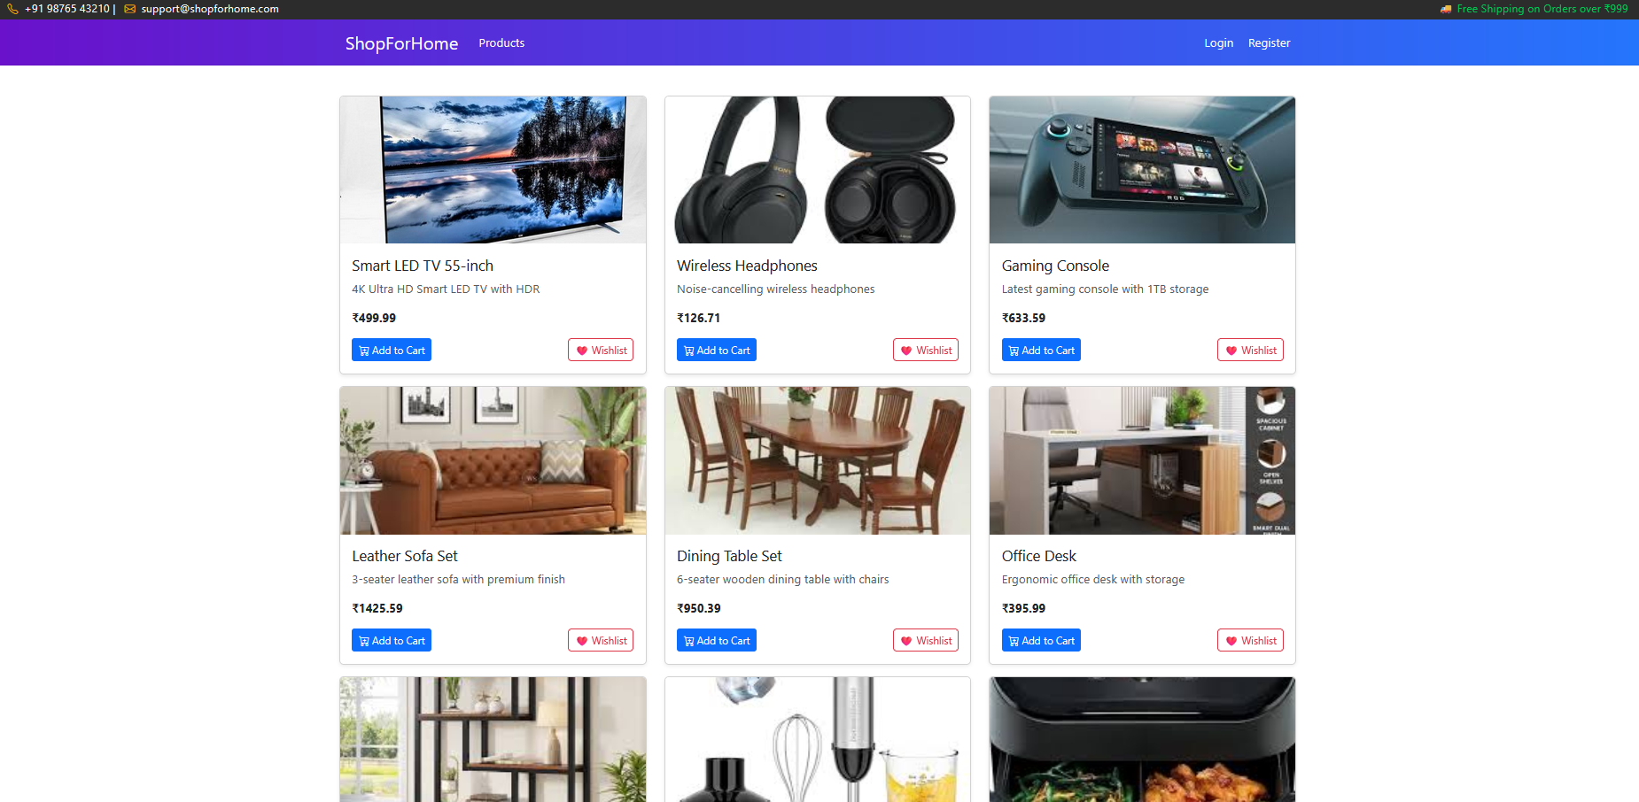
Admin

Slide 15
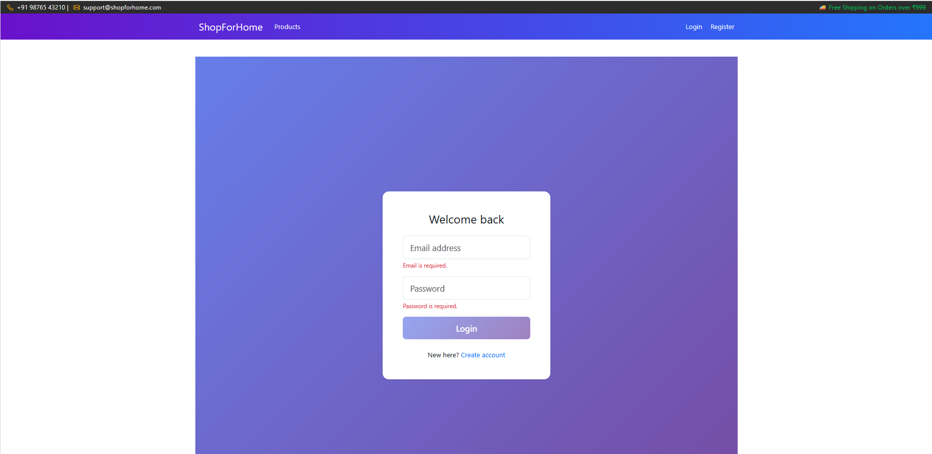

Slide 16
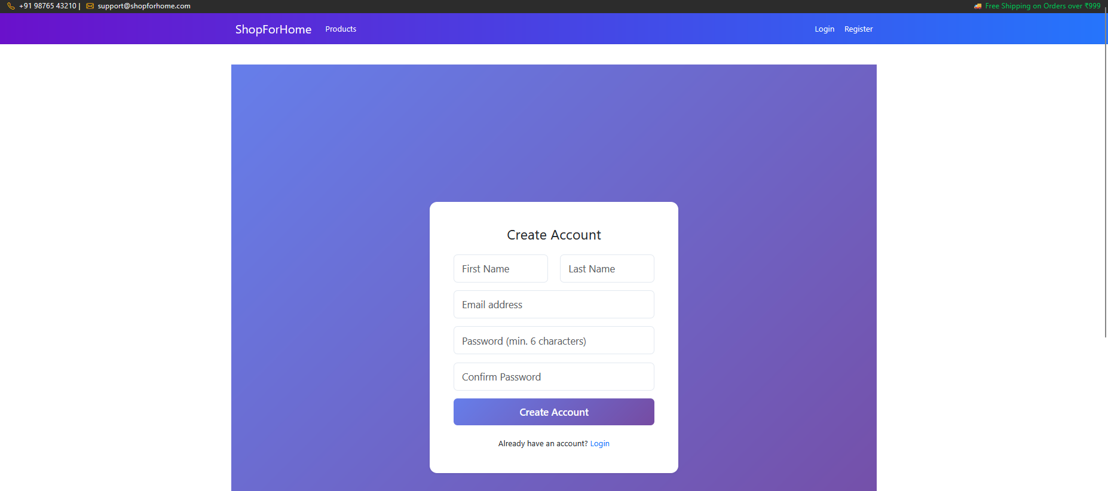

Slide 17
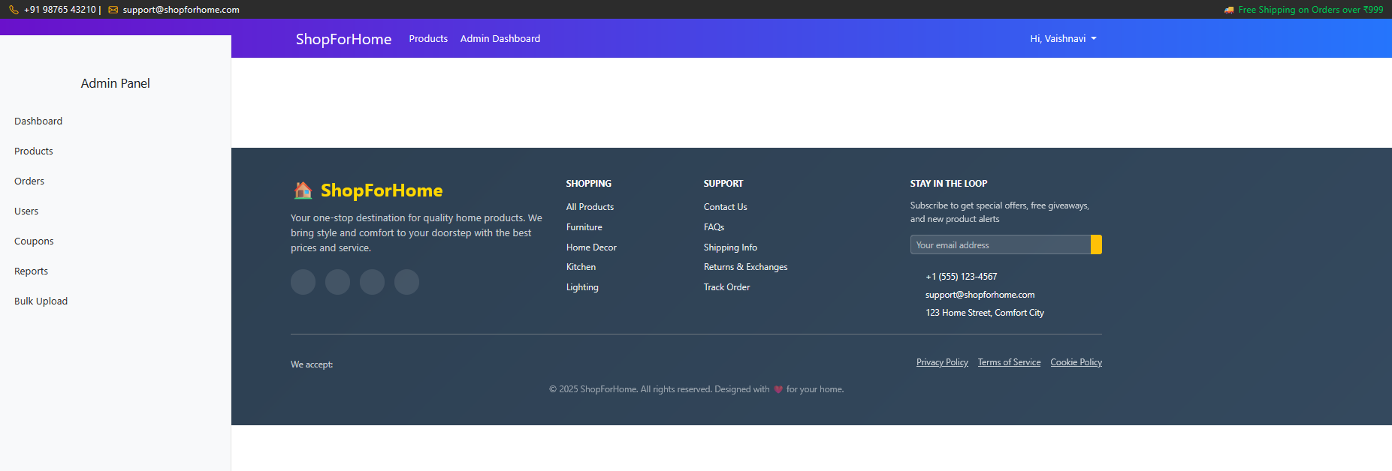

Slide 18
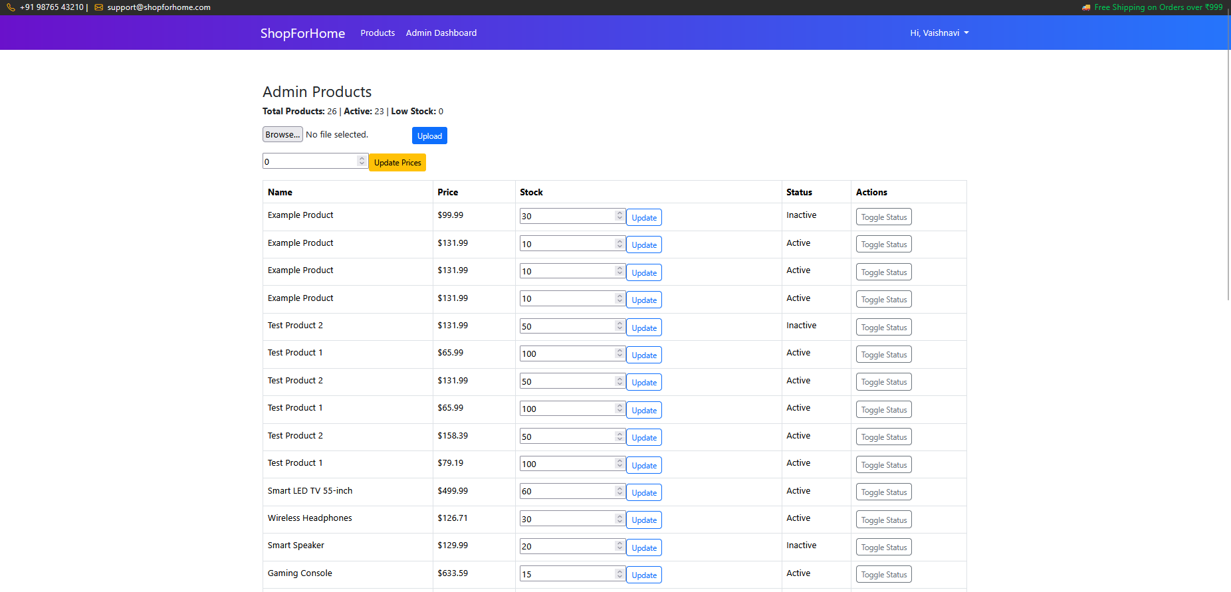

Slide 19
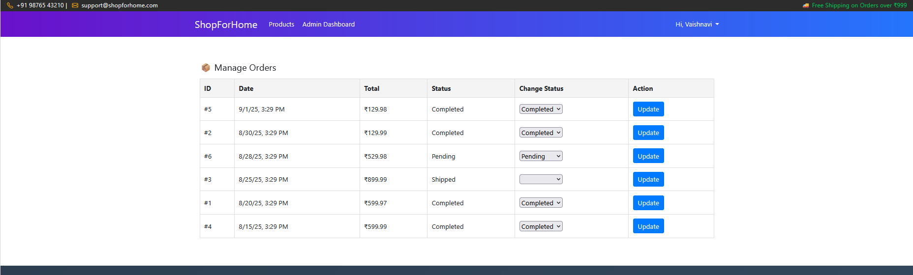

Slide 20
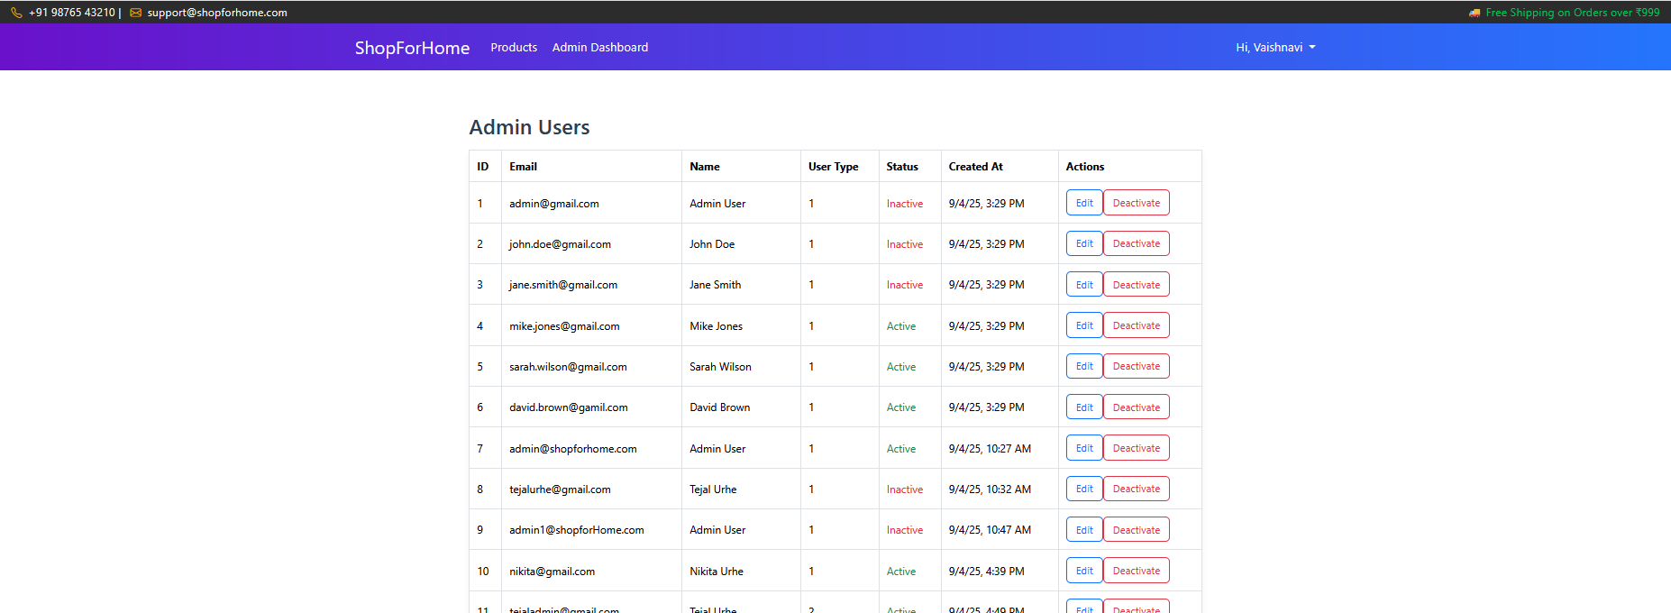

Slide 21
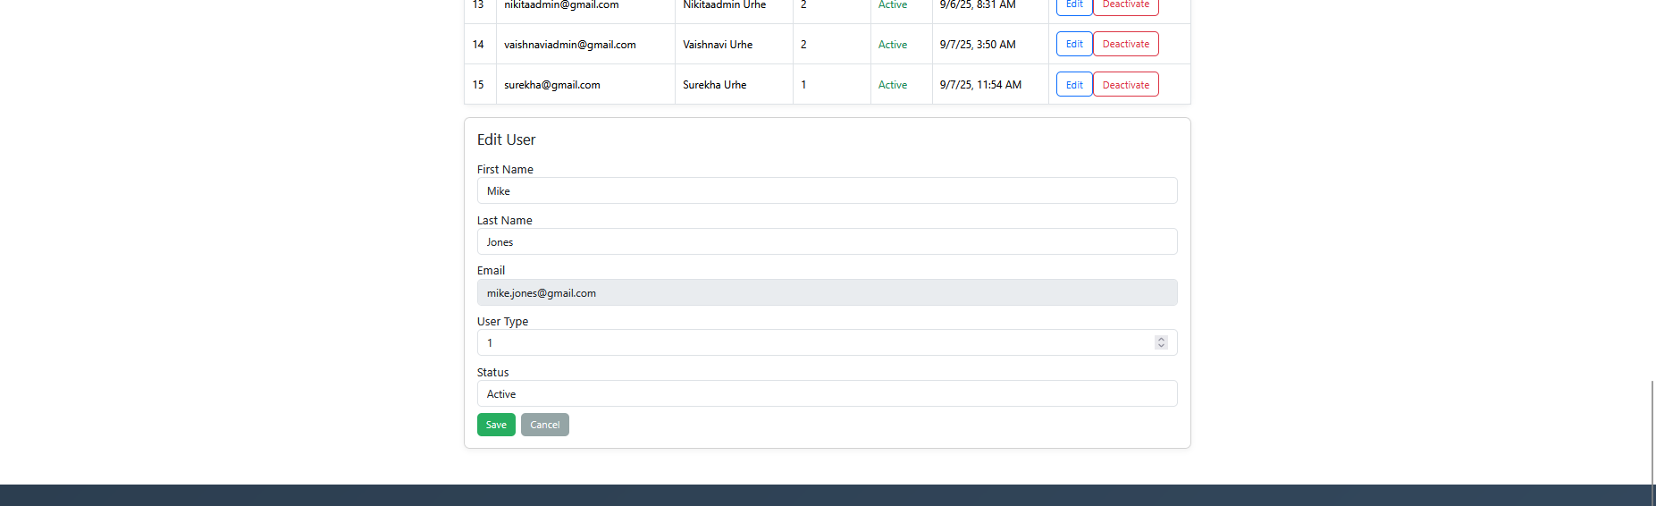

Slide 22
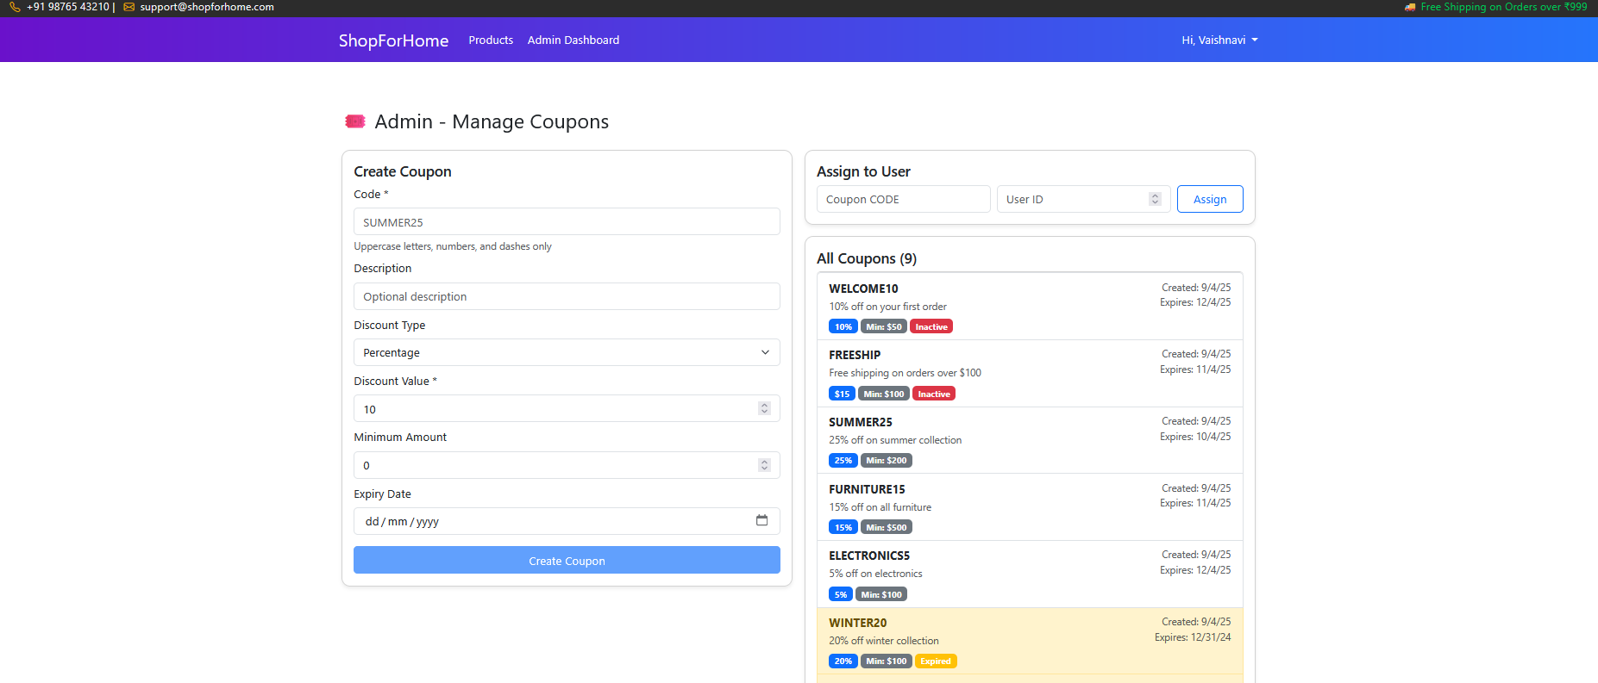

Slide 23
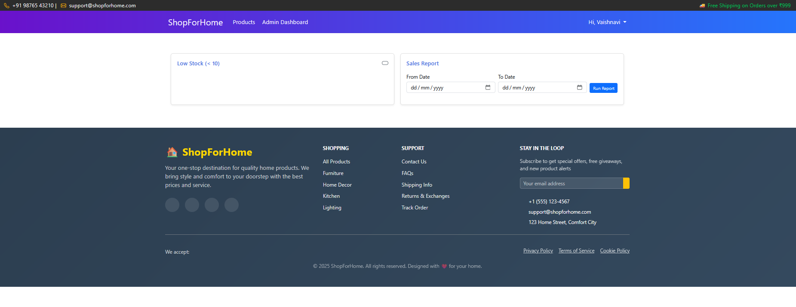

Slide 24
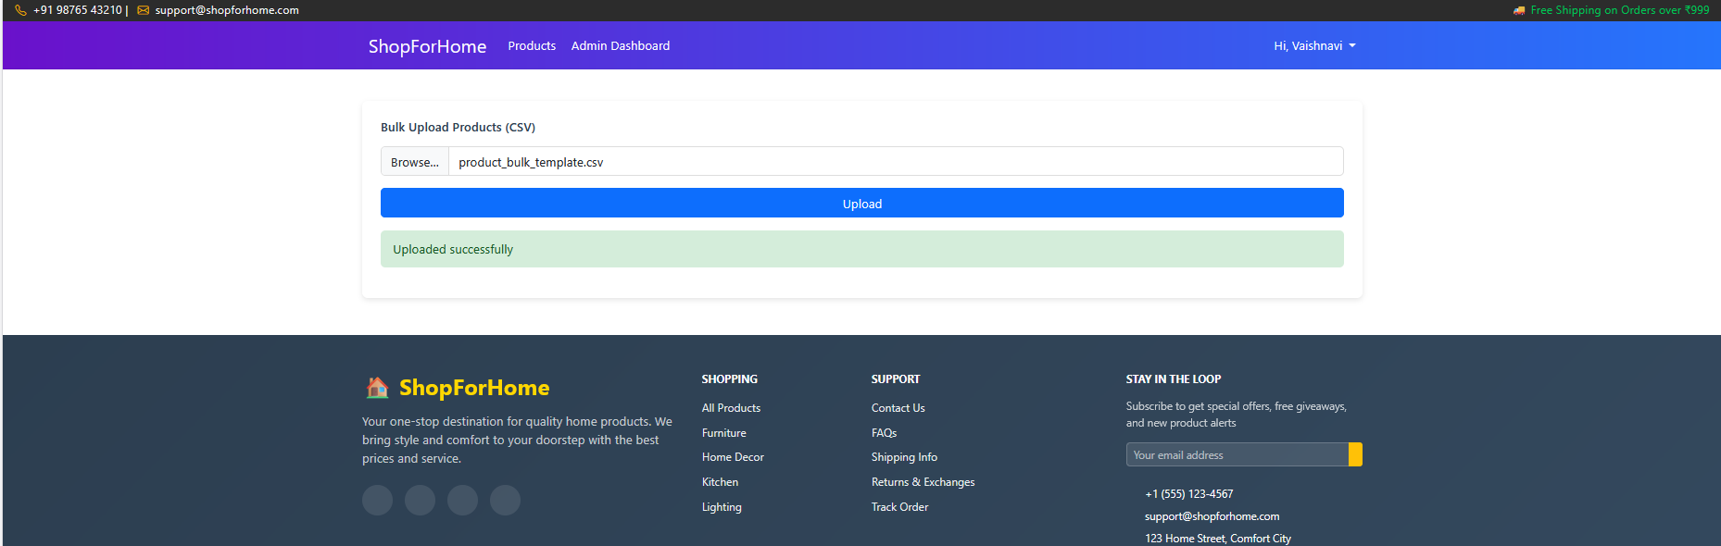

Slide 25
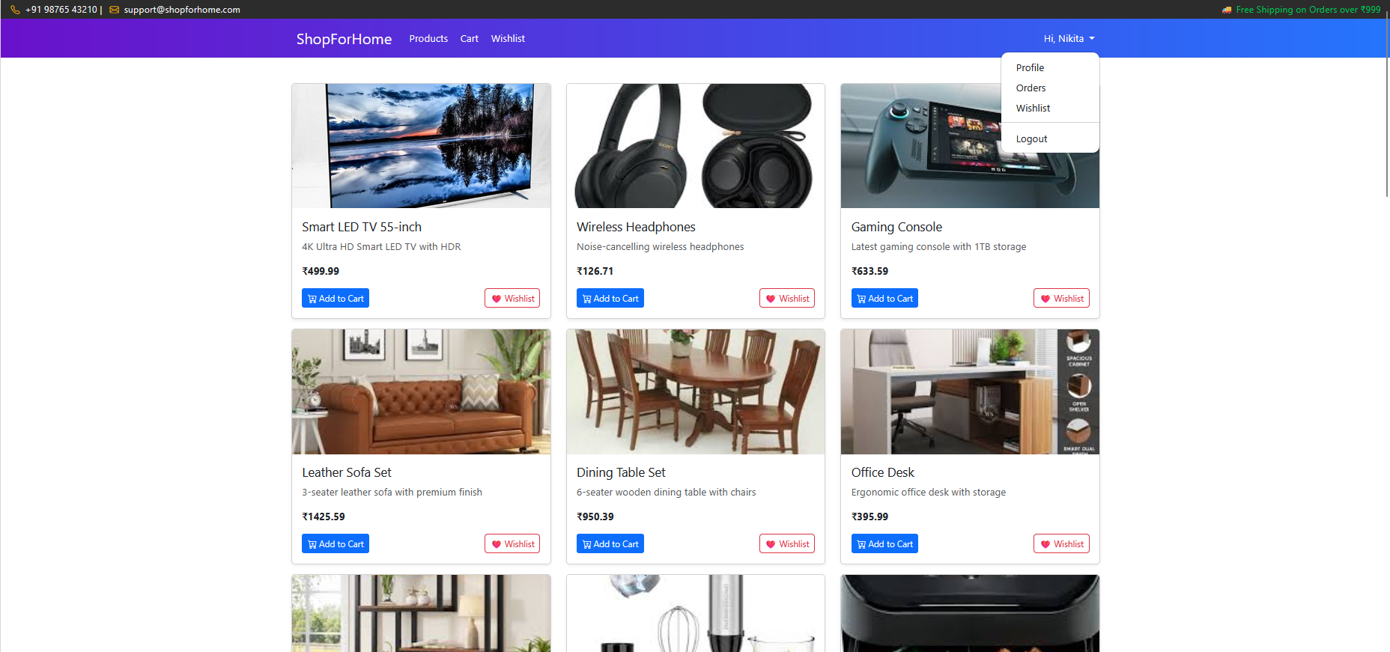
User

Slide 26
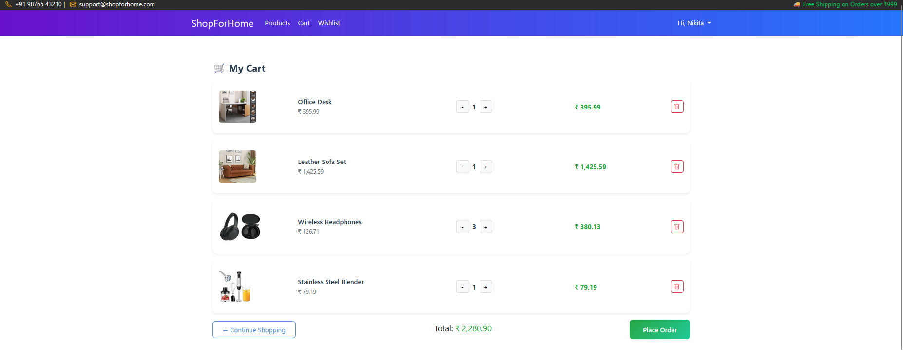

Slide 27
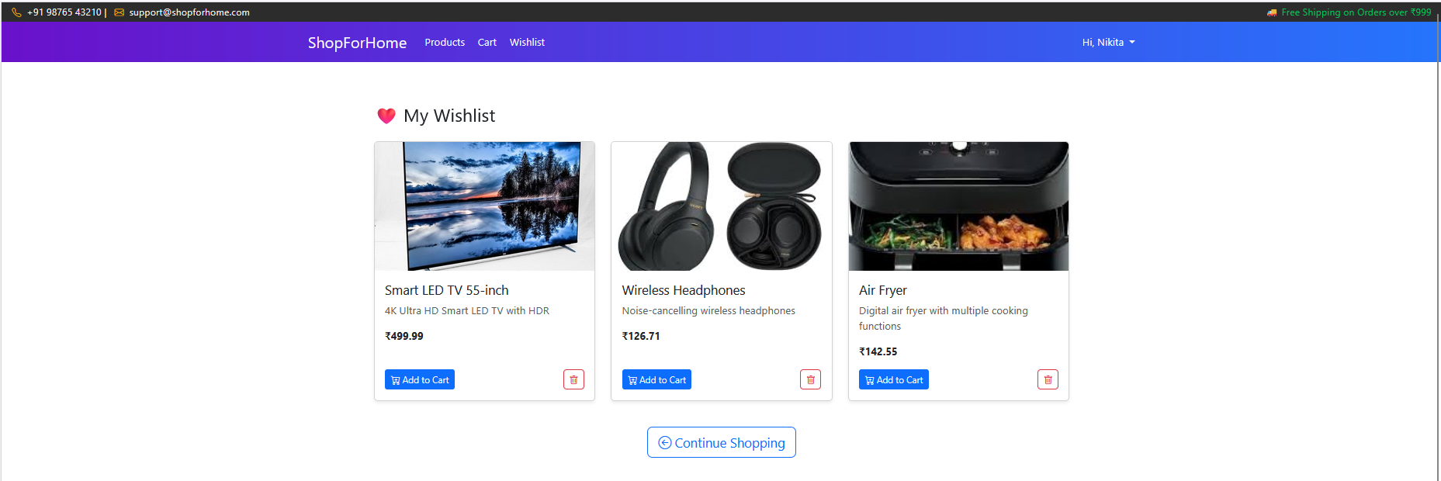

Slide 28
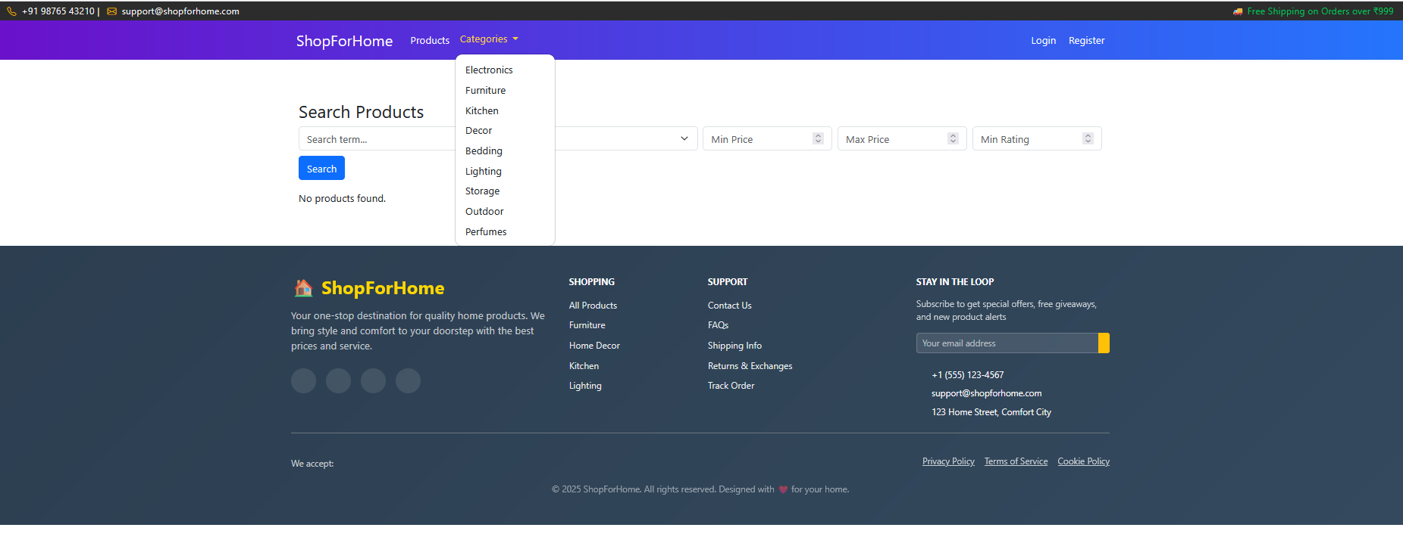

Slide 29
Thankyou !

